Slide 1
PEO Aviation Enterprise MOSA Strategy
Update to the Defense Standardization Program (DSP)
Modular Open Systems Approach (MOSA)
Mr. John T. Stough
Architecture SME (Contractor Support)
On behalf of Mr. Matt Sipe, Director of MOSA Transformation, PEO Aviation
DISTRIBUTION STATEMENT A: Approved for Public Release; Distribution is Unlimited
3 Aug 2022

Slide 2
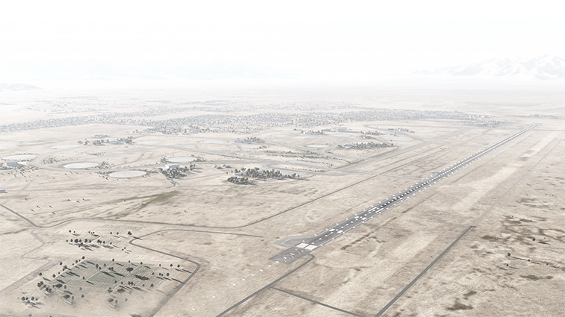
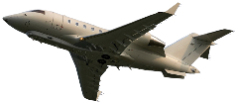
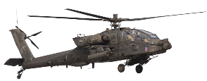

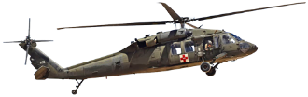
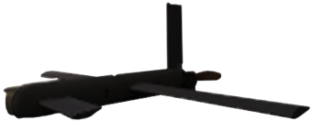
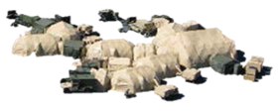



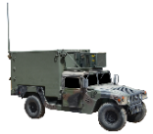




What is MOSA? Why MOSA Now?
MOSA is a technical and business strategy in which modularity and openness principles are applied in order to achieve a particular set of objectives.
Unique Inflection Point
Mandate for Rapid Capabilities to Pace
Threat Evolution
Must Accelerate Program Execution at the Speed of Technology
Affordability Paramount in Current Fiscal Environment
Opportunity to Leverage Across Future and Enduring Fleet is
Future Aviation Platforms
FARA, FLRAA, FTUAS
PEO Aviation MOSA Objectives
Improved Affordability
Increased Readiness
Enhanced Capabilities
Reduced Schedule Pressure
Reduced Supply Chain Risk
Sensors
ALE
COP
Maneuver Elements
Command Post
Mounted
Mobile Hand-held
NOW!
Engagement Throughout the Aviation Life Cycle to Optimize Value of MOSA
Notes:
Sir, this first chart is a modified definition of MOSA that we like to use to baseline what we mean in PEO AVN when we say MOSA.
It is certainly a technical approach but just as much so if not more it is a business strategy in which we simply apply modularity and openness principles to achieve a particular set of objectives SUCH as our PEO AVN objectives on the right hand side of the chart.
Additionally, this chart is meant to highly WHY MOSA is so important right NOW.
Simply put, the pace of our threats and the pace of technology are simply moving so fast that we have to change how we do the business of developing and delivering product to the field if we expect to not only modernize but remain relevant.
Additionally, our fiscal environment is such that business as norm will not work to achieve the above. Lastly, with multiple new starts, battlefield changing, with how we fight changing, the window for change is NOW.
If we don't develop and field FVL differently than programs of the past AND leverage that technology on the enduring fleet, then it will likely be another 1-2 decades before we get another significant opportunity to transform.
We have to engage products throughout the lifecycle and not miss opportunities to position ourselves better to optimize the value of MOSA.

Slide 3








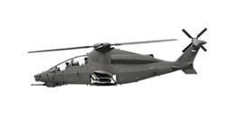





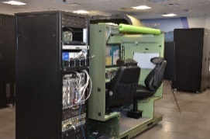




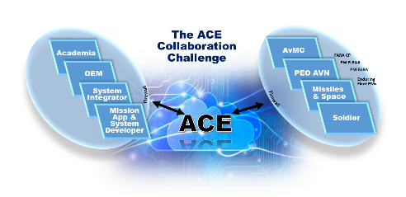






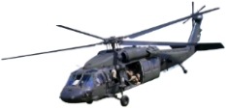


PEO Driving MOSA Transformation Effort
Aligning People, Tools, Processes for Successful Execution
      Current State
      MOSA 9 LOEs
      Future State
Industry
Creating Standardization, Increasing Communications, Applying Lessons Learned, Eliminating Stovepipes
Integrated, Aligned, Synchronized
Governance & Policy
Architecture & Standards
Software Development
Collaborative Digital Environment
MOSA Conformance Center
Qualification & Materiel Release
Affordability & Savings
Contracting
Strategic Communications
Requirements/
Validation
Science & Technology Evaluations
FY21 NDAA
MOSA ICRD
Maintenance and Sustainment
Holistic MOSA Application Across AVN Lifecycle
Product Design and Development
Science & Technology
ACWG/ICWG
Training and Deployment
Testing and Validation
IME
MSAD
Industry MOSA Investments
‘Ready to Catch’ Modernization Efforts
Notes:
Now, for PEO AVN to become a more MOSA centric organization some fairly substantial change is required.
As we assessed the Current State, we found a rich environment for MOSA Transformation.
Several mature and foundational standards
Significant industry IRAD investments
Significant pathfinding by S&T and other services
But ready for the AVN domain to leverage that ground work.
As a result, we stood up 9 Lines of Effort to help us eliminate stovepipes, apply the many lessons that the domain has been learning for many years, standardize our processes, and communicate a new way of doing business across the PEO and with our stakeholders.
So we took each of these 9 LoEs and started aligning the people, tools, and processes associated with these so that we could move into executing MOSA and progress toward a future state where our fleet is much more integrated, aligned and synchronize and to enable us to be better positioned as an enterprise to be ready to catch modernization efforts and not have to shelf them for decades.

Slide 4
MOSA Objectives
      MOSA TO Designed to Achieve Outcomes …
      … While Supporting Broader PEO MOSA Objectives …
      … and Aligned with MOSA ICRD Objectives
More Effective with Aligned Program Objectives and a Common End State
More Efficient with Reduced Duplication of Effort
Credible to Industry with Consistent Communication and Tangible Actions
Improved Affordability
Increased Readiness
Enhanced Capabilities
Reduced Schedule Pressure
Reduced Supply Chain Risk
Threat Based Capability Adaptability
Faster Fielding of Innovation to Achieve Overmatch
Total Lifecycle Affordability through Competition
Enabling Commonality

Slide 5
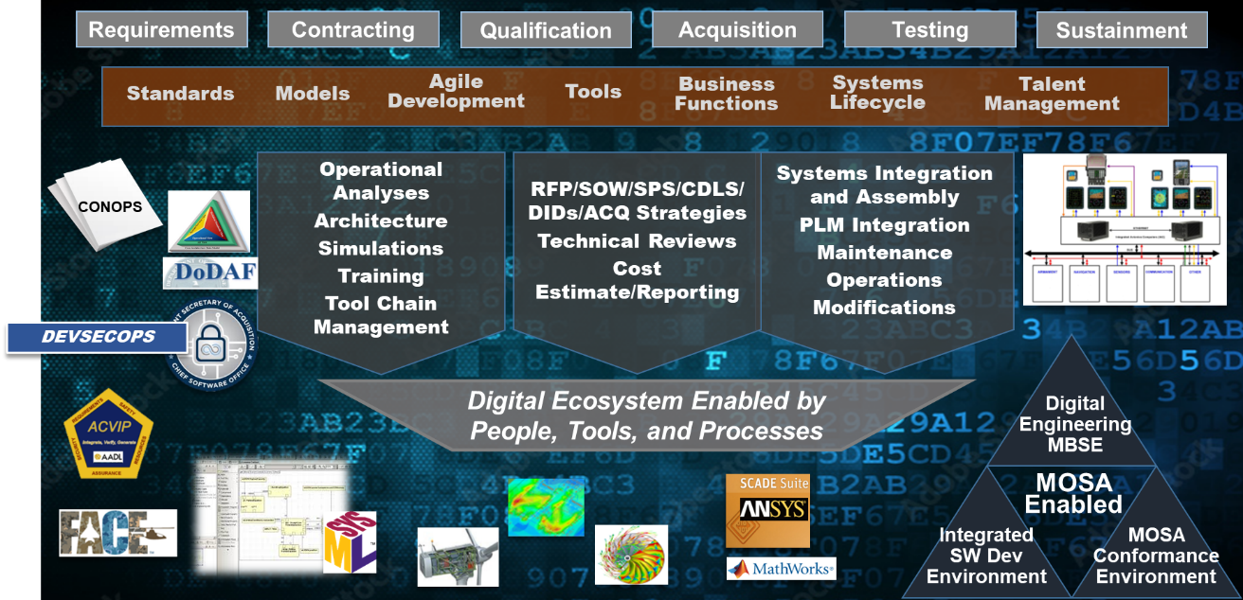
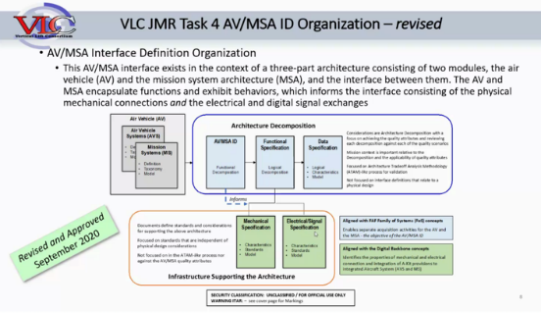
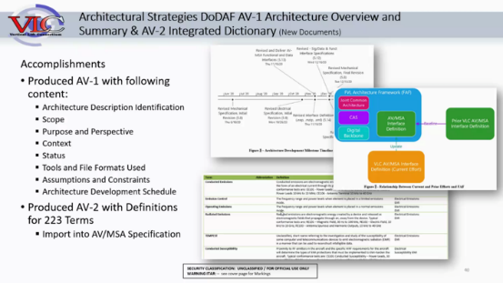
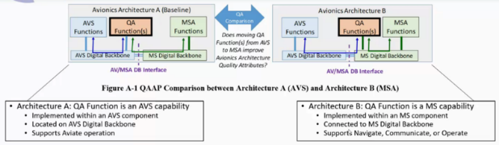
MOSA Requires an Enabling Digital Environment
Model-Based Procurement
  More than just delivery of Interface Control Documents (ICDs) and Technical Data Packages (TDPs)
  Component Specification Models (CSM) and Business Case Analysis across Families of Systems
  Systems-level Architectural collaboration prior to Design leveraging MBSE
Digital Ecosystem
  Work Product Environment & Tools
  Processes, Culture, & Training
  Active Industry Collaboration
Leveraging Vertical Lift Consortium (VLC) CRADA:
Suppliers and integrators must plant to move to model-based procurements and the digital ecosystem.

Slide 6
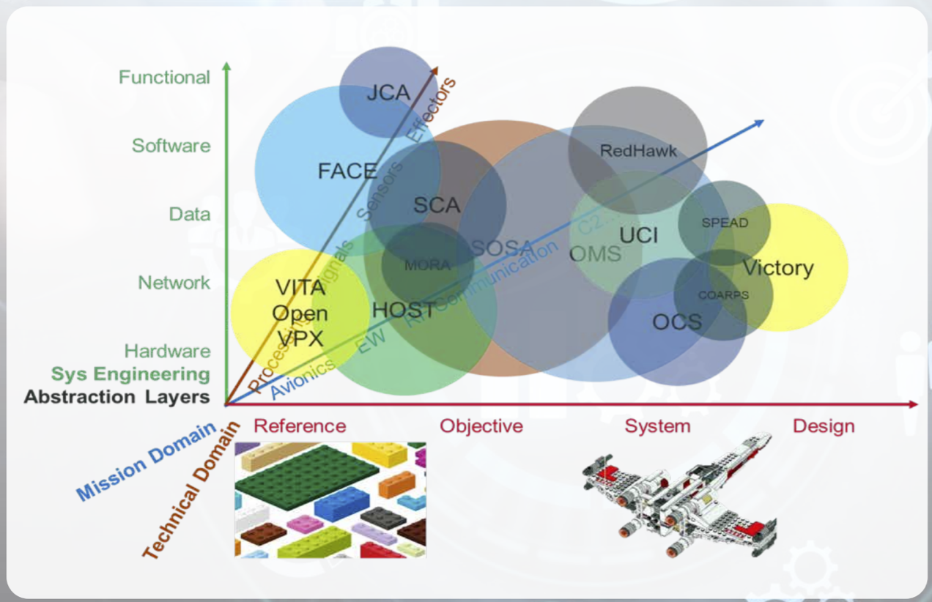
So Many Standards…
More than a Single Standard
  Mixed Criticality (SW and HW)
  Various Approaches to Data Models
  Different Abstraction Layers
    Mission Needs
    Functional Decomp
  Separation of Concerns
Standards Alignment
  Consortium Managed (FACE, SOSA)
  Gov’t Managed (OMS, HOST)
  Commercial (ARINC-661, ISO, SAE)
  Interoperability Initiatives
Need for Layered Guidance
  Cross-Service / Multi-PEO Shared Resource Interfaces
  Enterprise Level (Portfolio)
  Programmatic Level
  Design Artifacts / Integration
Image source: https://www.dsp.dla.mil/Portals/26/Documents/Publications/Journal/200101-DSPJ.pdf
While these various Standards overlap, they are complementary and can be coordinated with appropriate Enterprise guidance.
Notes:
Once a Technical Standard is started, the boundary lines of scope for that standard must be drawn clearly. In many cases, these standards overlap. That does not mean that because an overlap exists that the standards will naturally be interoperable. Consider the example of Imperial and Metric wrenches, where the overlap area is clear but the standards are not interchangeable. The more complex the standard, the lower the likelihood that random overlaps will result in natural points of interoperability. That requires coordination between the various standards bodies and the adopters to ensure that cases where multiple standards are needed for a single system or interoperable system of systems that the alignment efforts are well orchestrated. This Enterprise level guidance requires effort and input from portfolio and program managers as well as suppliers, integrators, and designers. This is highly relevant to our desired CMOA end-state as we must carefully focus our efforts to maximize our efficiency in the overlaps so that we can focus our unique efforts on our domain-specific applications and properly benefit from the common patterns in the shared-spaces.

Slide 7
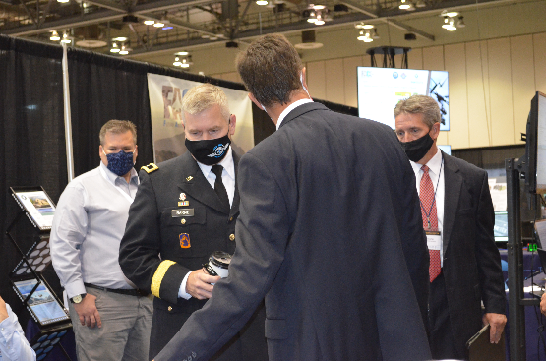
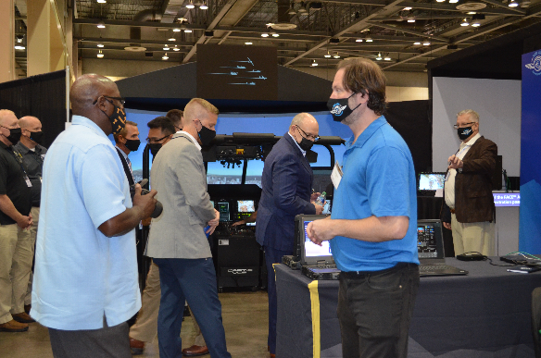

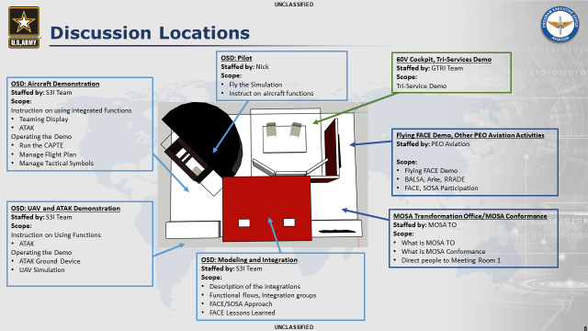
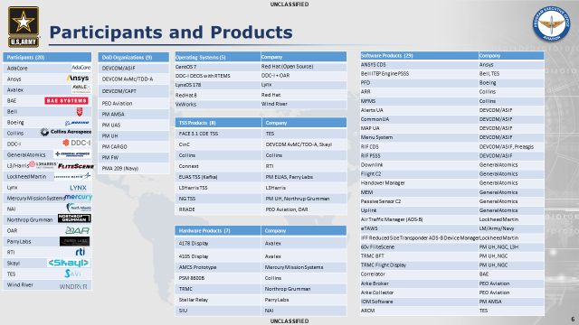
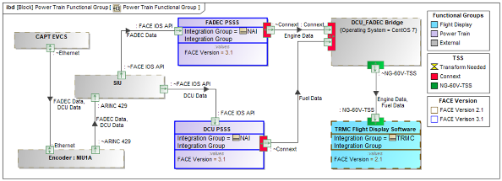
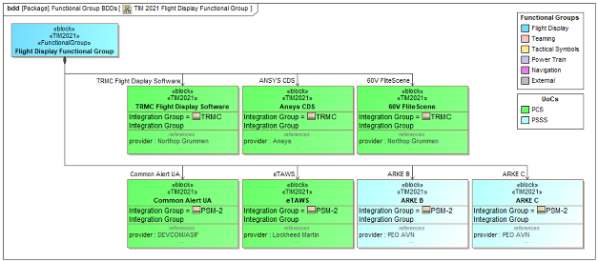
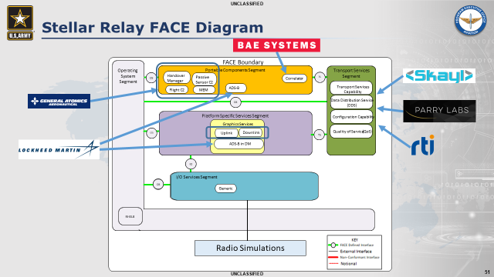
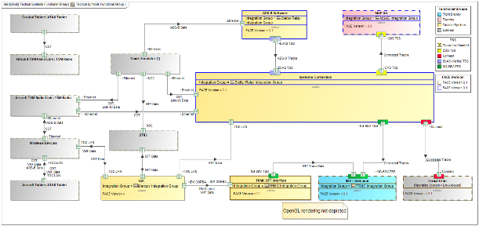
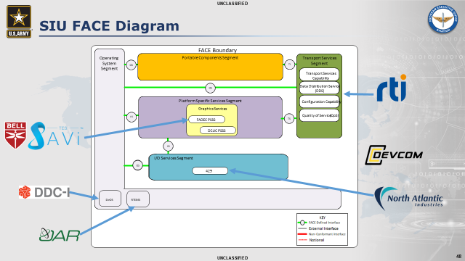
Army Aviation Open Systems Demonstration(s)
Multi-Consortium Events
  Tri-Services Open Architecture Demo
  Future Airborne Capabilities Environment (FACE) version 3
  Sensors Open System Architecture (SOSA) version 1
  Army Aviation Association of America
Continuous Improvement
  Integration Demos since 2016 TIM
  Dozens of published papers
  Cooperative rapid demos, focus on actual integration risk reduction
Army Open Systems Demo
  [Multiple Events] Army demo with ~20 vendors; integrated open systems
  Demonstrated freedom of action for PEO Aviation MOSA concerns
  Public Distro Website
(Inset slides from public released Industry team collaboration charts for Sept 14th 2021 FACE/SOSA TIM)
Notes:
Link to Army Open Systems Demo page: PEO Aviation's Modular Open Systems Demonstration | Article | The United States Army
Link to FACE TIM papers and presentations: Technical Interchange Meeting (TIM) Papers | The Open Group Website

Slide 8
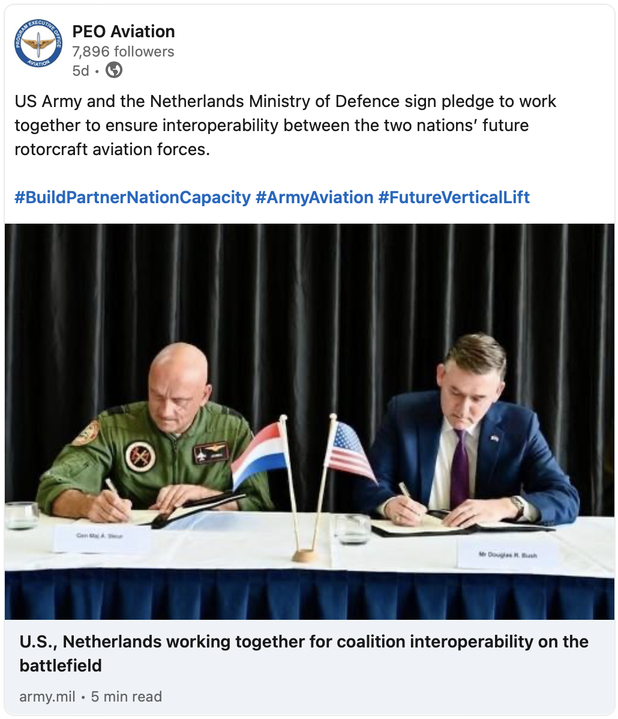
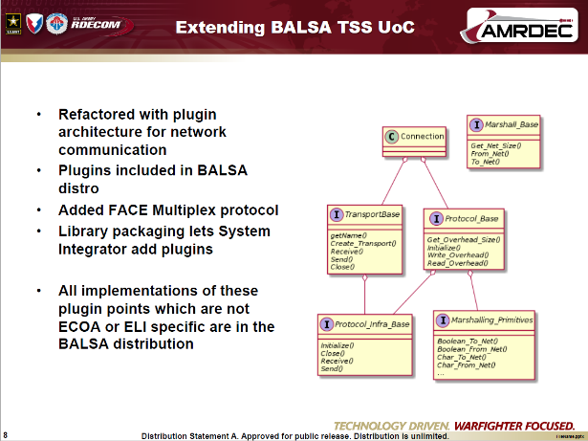
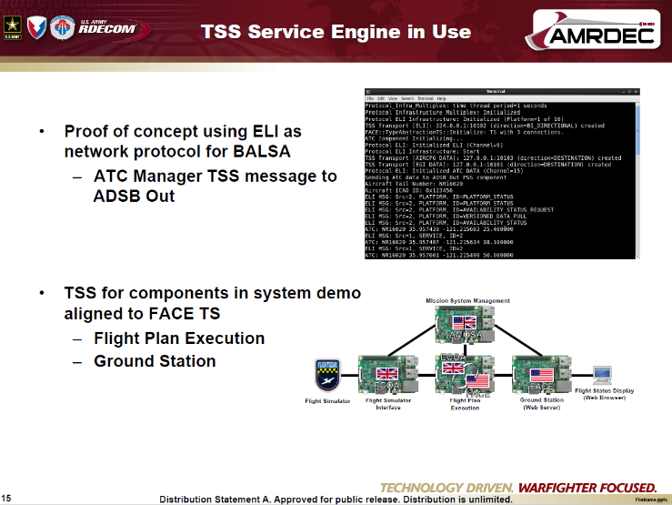

International Collaboration around Open Systems Technology
FMS Customers have some of the same challenges we do: MOSA is a Key Enabler
Benefits of MOSA for International Collaboration
  Reduction of burden on component level change
    Qualification and Airworthiness release
    Reusable and Replaceable functionality
    Platform agnostic enduring fleet enablers
  Speed of change for partner-unique mission systems
Multiple International Project Agreements
  Open Systems Demo as early as 2017 at FACE TIM, showing alignment to multinational standards
  Continued effort released Alignment to Multinational Open Systems Architectures (AMOSA) brief spec
  Ongoing collaboration on architectural and product line approaches
Article highlighting the most recent in a series of FVL International agreements highlighting MOSA
(Inset slides from public released 2017 FACE TIM for US/UK component demo)

Slide 9
Questions?

Slide 10
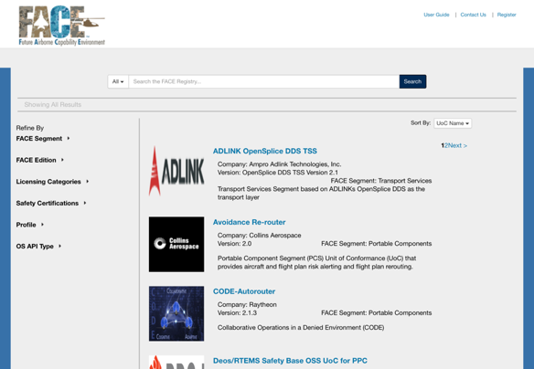
FACE Technical Standard Update
Future Airborne Capabilities Environment (FACE)
  Collaborative History: Army, Navy, and USAF participation
  Strong Multi-Vendor Ecosystem
Software Focused: 5 Segments
  Portable Component Segment (PCS)
  Platform-Specific Services Segment (PSSS)
  Transport Services Segment (TSS)
  Input/Output Services Segment (IOSS)
  Operating System Segment (OSS)
Strong PEO Aviation Participation
  Leadership Roles (Steering, Tech WG, Integration Committee, etc.)
  Regular Technical Interchange Meetings (TIM)
    Expo Events with Demonstrations
    Dozens of Peer-Reviewed Published Papers
  BALSA: Basic Avionics Lightweight Source Archetype
  Emergent Third-Party Tool Ecosystem
Public Software Repository
  Open-Source Example (BALSA in git for members)
  Distinction between Verification (tech) and Conformance (biz)
Recent Updates
  Active Software Component Conformance Program & Repository
  Significant Focus on “Getting Started” for Adoption & Onboarding
  Technical Standard ver. 3.1
  Established CCB / CR process (Corrigendum publication)
  Business & Contracting Guides
  Published Integrators Guide (new)
As of Dec 2020:
23 Components (UoCs)
Published by 13 Companies*
*Note: Numerous companies report dozens of components each that are not published, awaiting RFPs. For example, 40 candidate UoCs from 60V are being evaluated and >5 from MSAD… publication to the repository is a business decision and is not required.
Notes:
The FACE Technical Standard was created through a collaboration between the Government, both Army and Navy, and Industry partners to focus on the development of a future-oriented software design pattern for complex real-time safety critical applications specific to the domain of avionics. The current ecosystem is vibrant, with several hundred individual members from wide variety of industry participating companies and representatives from every service. New organizations are added all the time to this ecosystem, including new additions from the space community. The FACE Technical Standard is focused on segmenting the software portion of the avionics using an anonymous “publication and subscribe” architectural design pattern. This means that the source of data is unaware of the data consumer, to enforce loose coupling, and that the contents of that data are well documented by the enforcement of data architecture requirements, to ensure high alignment. Applications that then subscribe to data can be developed independently of the various producers, allowing each vendor to specialize in their specific area of expertise.
Early on in the development of the FACE Technical Standard, the PEO Aviation community realized the challenges with onboarding new members to this unique subject area. As a result, the involvement and leadership of PEO Aviation staff have helped shape the development towards demonstration and publication. This created a path for peer-reviewed technical papers and live integration demos that were strongly participated in by large and small businesses across every segment of the ecosystem. The Technical Interchange Meetings (TIM) continued even virtually throughout the COVID-19 quarantine period, though the Expo demonstrations have slowed due to the value of in-person participation.
One very specific valuable addition from PEO Aviation to the FACE Ecosystem was the development and public release of a sample FACE application stack called BALSA: The Basic Avionics Lightweight Source Archetype. This was created initially as a “Code Challenge” to ensure that college students would have a “Hello World” example to use in onboarding new staff. The code was quickly adopted by the Consortium for use in reference examples and has since been furthered by tool vendors for use in their FACE-aligned tooling to create a common reference example to further aid in adoption.
The FACE Technical Standard is accompanied by not only the peer-reviewed papers but importantly by a managed guidance for Business, Integrators, and Contracting and Conformance. There are independent Verification Authorities (both government and commercial) as well as a formal Conformance program. It is important to note that Verification is a technical activity, while formal Conformance Certification is a business decision. Businesses are not required to publish their components to the public repository and many choose to delay public announcements in anticipation of government RFPs. Also, while alignment is of significant value, the formal Conformance business decision may not be elected by vendors or the government until an actual reuse case demonstrates the need; this can be shown in the more than 40 FACE-aligned components from the UH-60V program and the more than 5 components from the Mission Systems Architecture Demonstration (MSAD) for Future Vertical Lift S&T. The slide above also indicates a number of recent updates that indicate the health of the FACE Consortium, technical contributions from industry and government participation, and adoption across the board.

Slide 11
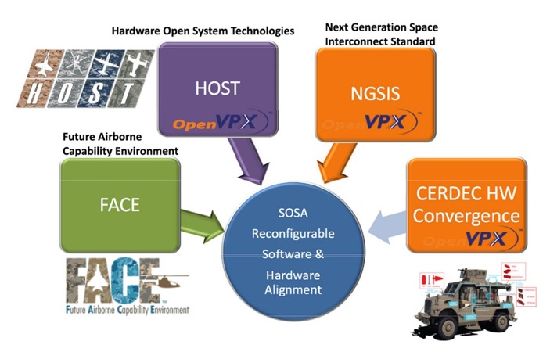
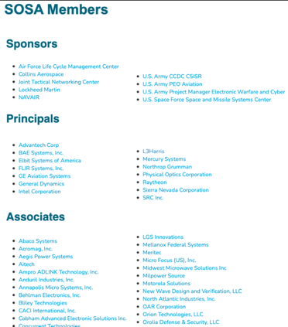
SOSA – an example of a Standard of Standards
Sensors Open Systems Architecture (SOSA)
  Managed by The Open Group
  Planned Distro A Release (w/ Limited Distro Appendices)
  Participation from Army, Navy, USAF, and Industry
  Began out of FACE, HOST, and OMS Standards Alignment
  Broad cross-service and cross-industry participation
Leverages Ground HW Systems Standards
  VICTORY
  CMOSS
  MORA
Overlaps & Incorporates Numerous Standards
  Focus on cross-domain sensor integration
  Covers HW & SW
  Consideration of Ground, Air, and Space
Opportunity to Influence
  Early Interop Demo Completed (USAF Funded)
  Nearing V1.0 Release (Expected Mid-FY21)
  Recommend Greater Army Involvement (Other Domains?)
Why Another Standard? Enables greater agility through subsystem upgradability across PEOs and Vendors…
Notes:
One example of this alignment was the creation of the new Sensors Open Systems Architecture (SOSA) Consortium. This grew out of the FACE Consortium because of the need for Hardware (HW) and Software (SW) convergence issues unique to the application of sensor technologies. Because of this, the SOSA standard has the ambitious objective of aligning numerous standards to create an ecosystem where the many vendors, integrators, and program offices that need to come together to create a reusable sensor across many platforms (ground, air, and space), will need to cross the domain already covered by existing standards. This is of interest with respect to our CMOA objectives. Version 1 focus is on rules and infrastructure. Specifics of mission operations will not be defined until Ver 2.x. Potential for a natural break-point on High Level objectives (including qualities and standards alignment) with subsystem deep technical standards (e.g. System-of-systems with Sensor subsystem tech standard edition now, weapons or ASE effectors as alternative subsystems). ASE use of SOSA is presently very limited, due to unique concerns, it is both sensor + effector in fast automated decision cycle. Single control system for moving from listening to countermeasures (e.g. jamming or flare dispenser). Multi-purpose small systems (ALE, etc.) currently beyond “sensor” scope; USAF sees ALE chassis size issues as highly synergistic (e.g. launch tube size, etc.), could apply to Army UAS / ALE efforts.

Slide 12
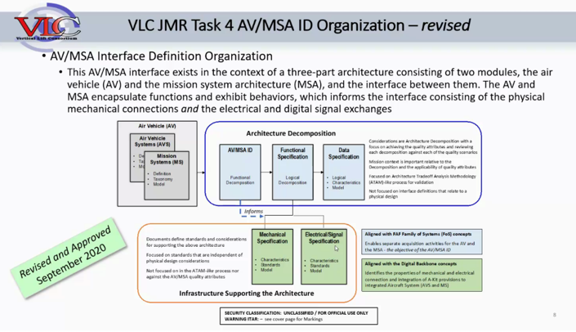

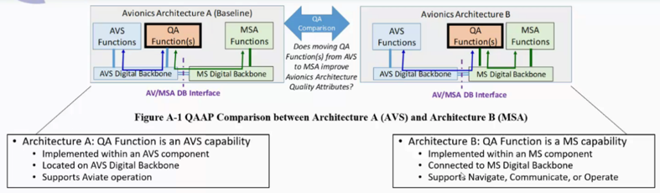
Example: VLC Task AV/MSA IDD
Multi-Vendor w/Gov Lead
  Vertical Lift Consortium (VLC) open-to-industry task
  USG Funding and Leadership, Numerous Vendors, One-Team
  S&T Transition to PEO (FVL focus)
Air Vehicle (AV) and Mission System (MS) Interface Description (ID)
  Functional Decomposition to define 332 unique functions at a modular / component level
  Decomposes / Integrates MIL-STD-881 & Joint Common Architecture
  Includes low level autonomy / cognitive decision aid (~90 functions)
Extensive use of MBSE
  Style Guides
  Model Validation
Trace to Broadly Adopted Processes
  Highly aligned to FACE Approach for SW
  Inclusive of HOST and SOSA for HW
  Use of ISO 42010 Architecture Description
  Architecture Tradeoff Analysis Method (ATAM™) is an SEI best practice using Quality Attributes for comparative analysis
Strong Industry Buy-in For More Granular & Modular Interfaces
Notes:
Functional decomposition is also critical and very often not within the scope of the various Technical Standards. Technical Standards focus on the interface (consider USB) rather than the end-use application (consider a speakerphone, hard drive, or other end-item tech that uses the USB interface). To get to actual commonality, the functions performed in common must be composed together. In order to accomplish this in the Vertical Lift space, the Army coordinated with another consortium that represents the specific contracting aspects (using an OTA structure) called the Vertical Lift Consortium (VLC). This task allowed for the definition of an Air Vehicle to Mission Systems Architecture (MSA) boundary and decomposition of the specific functions for use in the FVL specification.

Slide 13
Evolution of MOSA Guidance
OSD PM Guide: MOSA for Acquisition
Defines 5 Principles for MOSA
U.S. Code 2446a
MOSA is an Integrated Business and Technical Strategy
ASA(ALT) MOSA Implementation Guide
Requires PEOs to provide MOSA Guidance
Requires Project Assessment IAW 5 Principles
2004
NDAA FY17
MOSA in Acquisition Strategies With Focus on Major System Interfaces
AAE Memo: Policy Guidance on Implementing MOSA
Requirements for PEOs and PMs
2017
2013
2020
DoD OSA Guidebook for PMs
Recommends MOSA, OSA, and
OSMP in Acquisitions
2019
2021
Tri-Services Memo: MOSAs for Our Weapon Systems is a Warfighting Imperative
Cites Open Standards Including FACE
NDAA FY21
Extends Guidance to
Modular System Interfaces

